Slide 1


Flight Data Visualisation
Group 30:
Nagib Shah | (470360839)
Xinan Ma | (470489934)
Alan Shen | (470194809)
Young Choi | (470346338)
Qiushi Zhang | (470119101)
Girishkumar Dhotarkar | (470351620)

Slide 2



00
I Believe I Can Fly...
COMP5048 Group 30

Slide 3
01
Introduction
The Flight(delay) dataset contains largely US domestic flight network and performance details consisting of approximately 120 million flight arrival and departure information, metrics, and statistics ranging from the years 1987 till 2008, and also contains airline, airport, and aircraft information.
Dataset
• Build Visualization system for flight (delay) dataset
• Visualise overview airline networks in US
• Visualise best time of year for travelling with minimal flight delays.
• Visualise performance of airports and carrier year on year.
• Visualise negative effect of specific incident or event on flight delay.
• Give traveling guide to hitchhikers based on visualization analysis.
Aim
COMP5048 Group 30

Slide 4
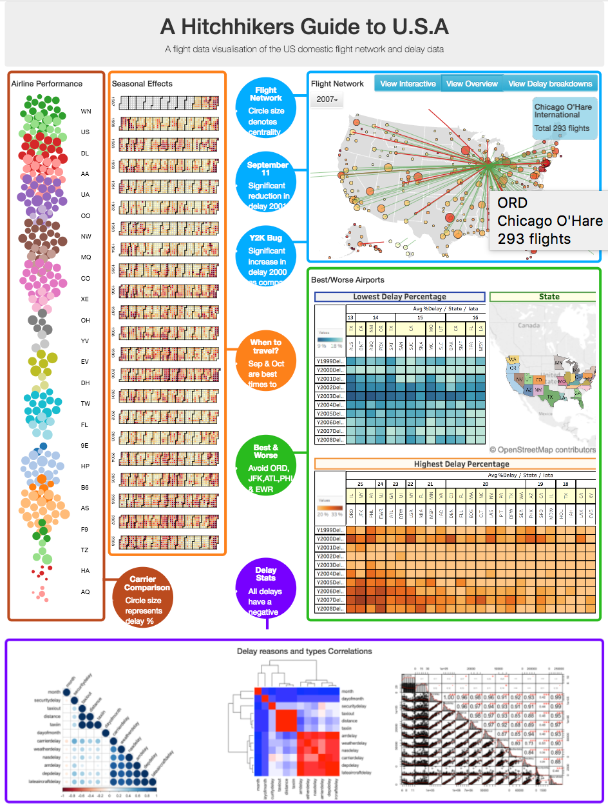
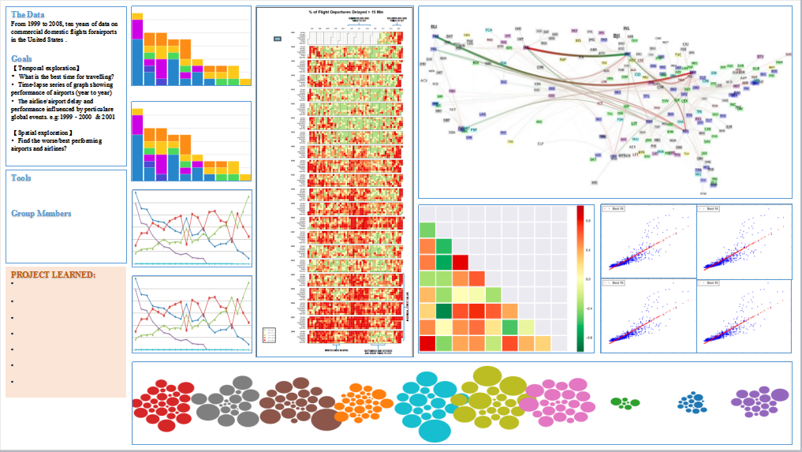
Design
-Visualization System
02
Visualisation | Layout | Tool
Flight Network | Geo-spatial Layout | D3 ArcGIS
Seasonal Effects | Calendar Layout | D3
Airline Performance | Bubble Chart Layout | D3
Airport Performance | Heat map Layout | Tableau
Statistical Analysis | Correlation Matrix | R
COMP5048 Group 30

Slide 5
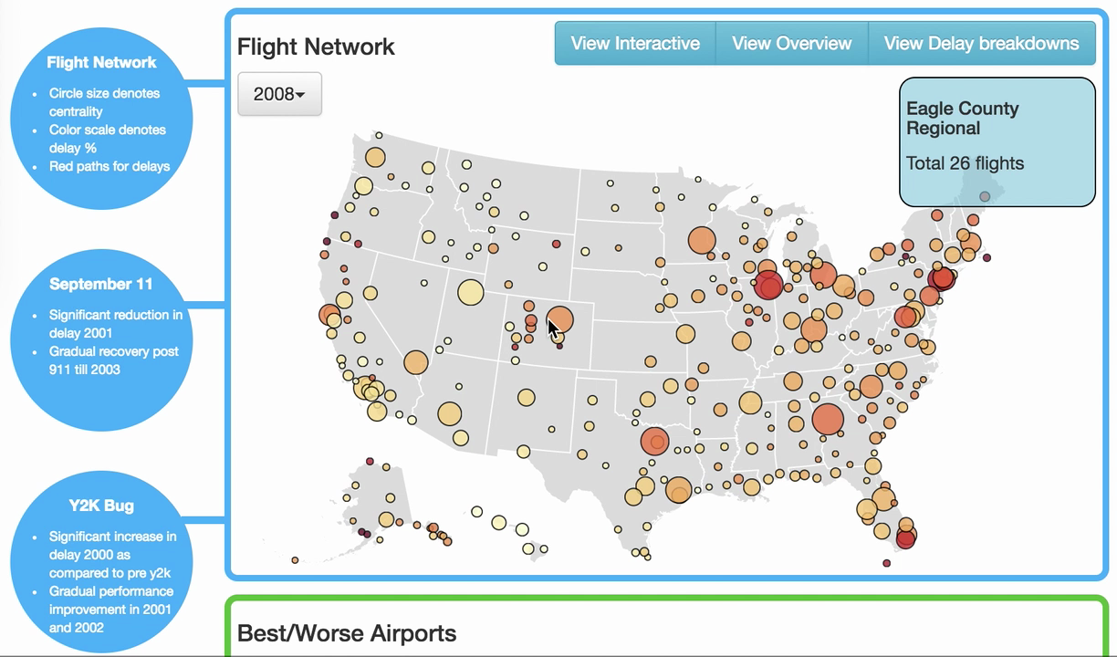
Design-Flight Network
02
COMP5048 Group 30

Slide 6
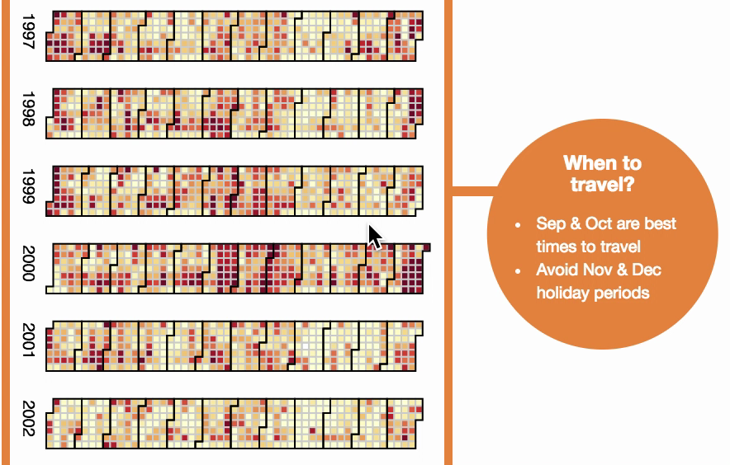
Design-Seasonal Effect
02
COMP5048 Group 30

Slide 7
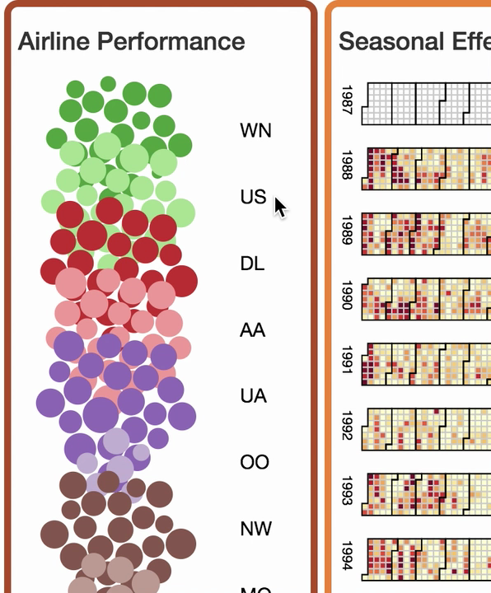
Design-Airline Performance
02
COMP5048 Group 30

Slide 8
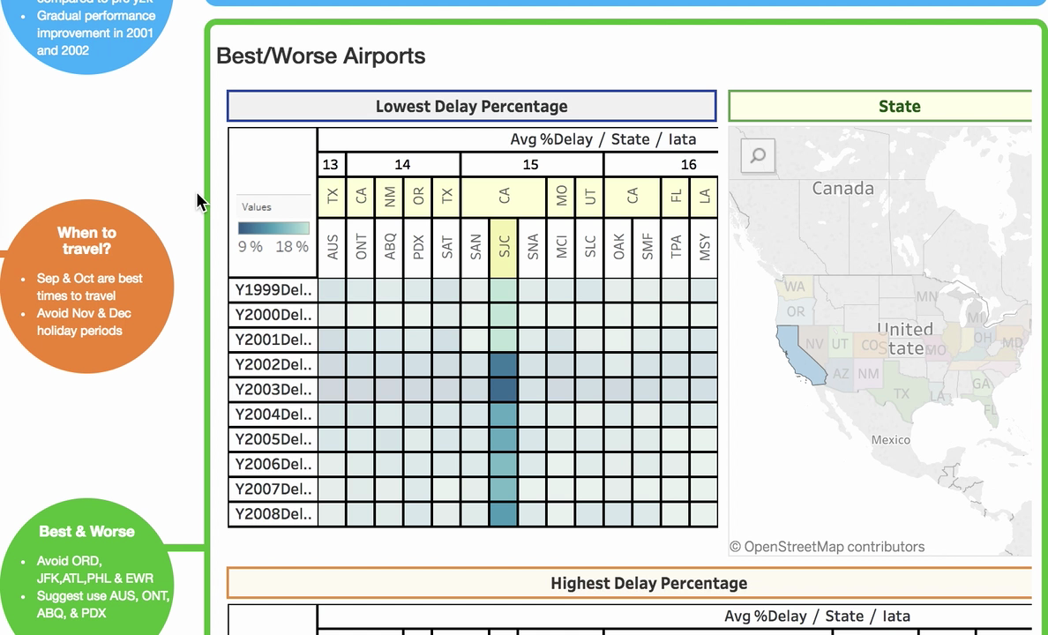
Design-Airports Performance
02
COMP5048 Group 30

Slide 9
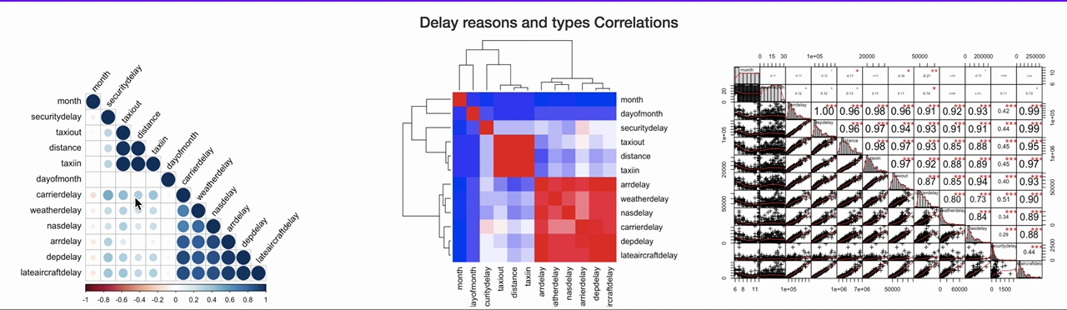
Design-Statistical Analysis
02
COMP5048 Group 30

Slide 10

03
Implementation
Deliver VA System & Final Report
Evaluate visualisation & Presentation
Build & Integrate visualisation system
Peer review and Prepare Initial report
Design, Develop code or use software tools to visualise and perform QA
Develop & test queries for each visualization
Cleanse data and Create Indexes
Extract & Load of data
COMP5048 Group 30

Slide 11

04
Evaluation
Data/ Visualisation | Task(s) | Evaluationn framework/ Methods
Primary Interactive Flight Network | Identify critical routes Identify critical airports/nodes Summary of overall network | Survey (Questionnaire, Focused group)
Seasonal Effects | Identify month(s) for travel Identify month(s) to avoid for travel | Analytic inspection (Cognitive walkthroughs)
Airline Performance | Identify Best Airline Identify Worst Airline | Empirical evaluation (statistical analysis)
Airport Performance | Identify best Airport Identify Worst Airport | Empirical evaluation (statistical analysis)
Statistical Analysis | Identify main reasons for flight delay | Empirical evaluation (statistical analysis)
COMP5048 Group 30

Slide 12

05
Progress
Project Status:
Green (Ahead of Schedule)
Release VA system & Final Report
Submission
Report 1
02/Nov/17
Kick-Off
Presentation
15/Sep/17
28/Sep/17
12/Oct/17
09/2017
15 Sep-21 Sep
22 Sep- 28 Sep
29 Sep-05 Oct
06 Oct-12 Oct
13 Oct-19 Oct
20 Oct-26 Oct
27 Oct-02 Nov
11/2017
Data Set Selection
Design Completed
Development Completed
Evaluation Complete
Final Report
100%
20%
VA Design
& Report 1
100%
Flight Network 95%
Seasonal Effect 95%
Development & Unit Testing
Airline Performance 95%
Airport Performance 95%
Correlation Matrix 95%
Integration Of VA System & Presentation PPT
95%
Evaluation
40%
15%
Documentation Final Report
0%
100%
COMP5048 Group 30

Slide 13
06
Planning
Planning Task | Start Date | End Date | Task Owner
Evaluation | 13-Oct | 19-Oct
Survey Result
Statistical Analysis
Cognitive walkthroughs
Adjustment to VA based on Survey
Final Submission Documentation | 5-Oct | 19-Oct
Initial Draft | 5-Oct | 19-Oct
Review | 5-Oct | 19-Oct
Finalize Initial Report | 5-Oct | 19-Oct
COMP5048 Group 30

Slide 14
GROUP 30
THANK YOU
Q&A TIME

